Slide 1
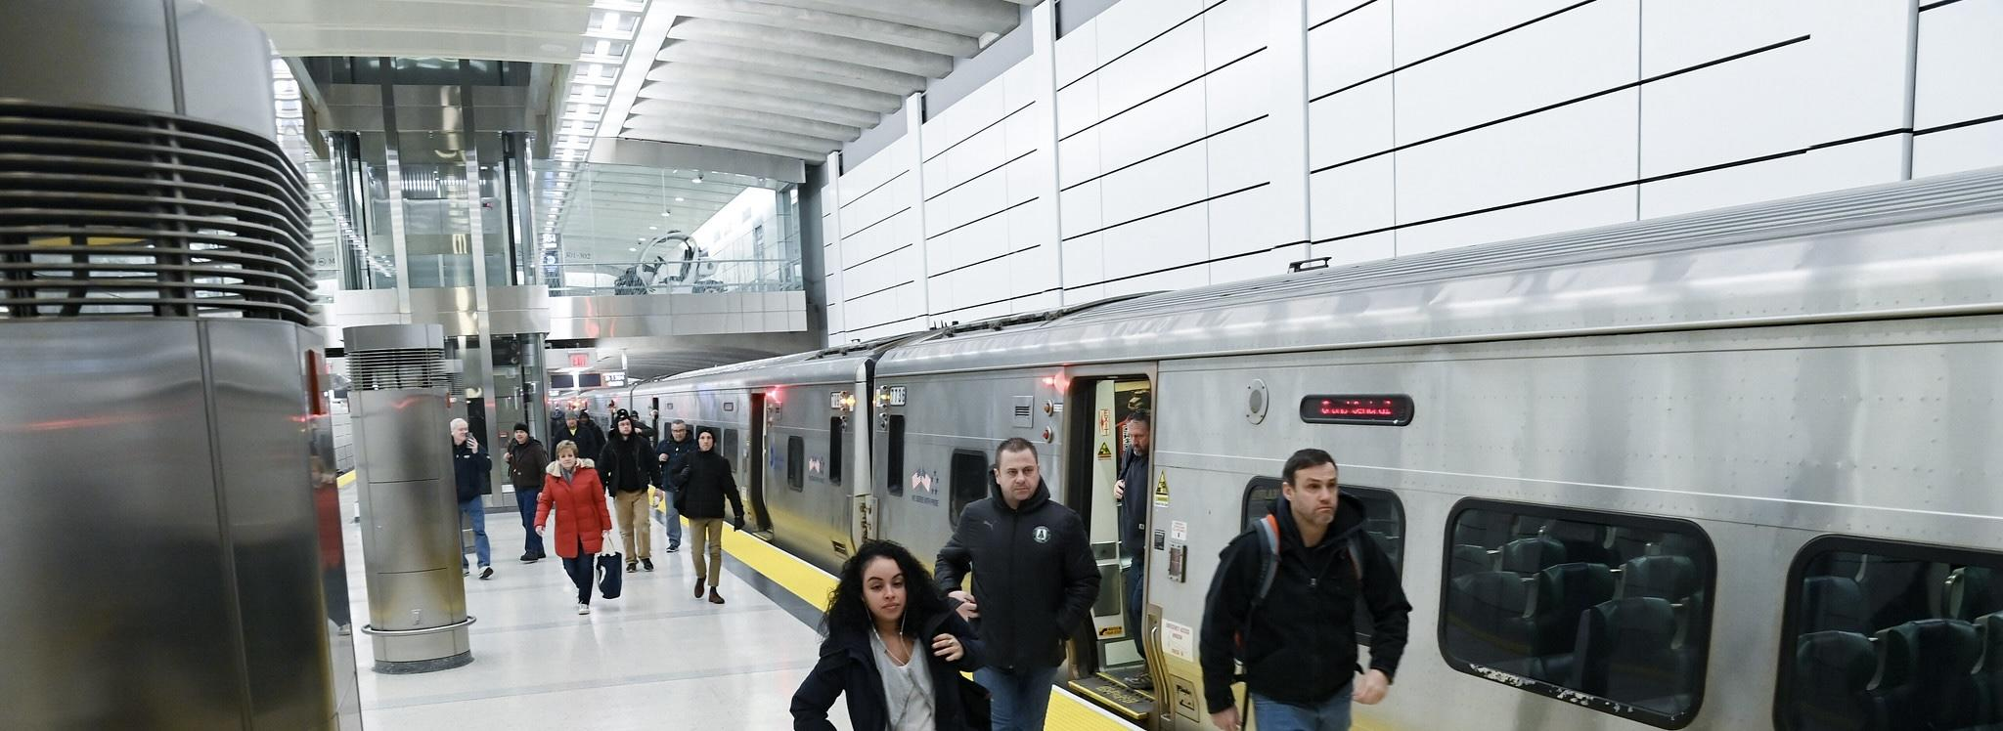




MTA
“The Metropolitan Transportation Authority”

Slide 2



Team Members
1- Mohamed Fathy.
2- Mostafa Gamal.
3- Zenib Ibrahim.
4- Hazem.
5- Esraa ElMalawy.
6- Abanob Samir.

Slide 3

Introduction
The Metropolitan Transportation Authority (MTA) is the largest transit network in North America.
It serves 12 counties in southeastern New York and 2 in Connecticut.Includes subway, bus, commuter rail, paratransit, and bridges/tunnels.

Slide 4

Project Objective
Analyze MTA ridership trends pre- and post-pandemic.
Identify recovery patterns and peak ridership times.
Provide insights for future transportation planning.

Slide 5

Data Sources
MTA Daily Ridership Data (CSV)
NYC COVID-19 Cases (CSV, XLSX)
Ticket Revenue Data (XLSX)
Subway (NYCT)
Buses (NYCT, MTABC)
Long Island Rail Road (LIRR)
Metro-North Railroad (MNR)
Bridges and Tunnels (B&T)
Comparison in etween Pre-pandemic vs. Post-pandemic ridership

Slide 6

Data Collection Methodology
Subway and bus ridership data from MetroCard/OMNY transactions.
Commuter rail ridership estimated using ticket sales.
Traffic data collected via toll systems.

Slide 7

Steps in Power Query

Slide 8
Steps in Power Query
Loaded data from multiple sources.
Removed duplicate and unnecessary columns.
Handled missing values.
Formatted date and numerical fields.
Created calculated columns for analysis
Standardized date and time formats.
Created new calculated fields using DAX

Slide 9
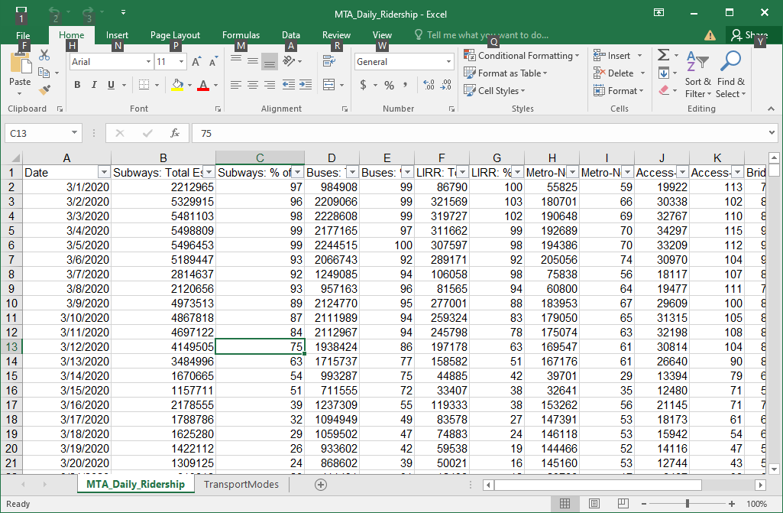
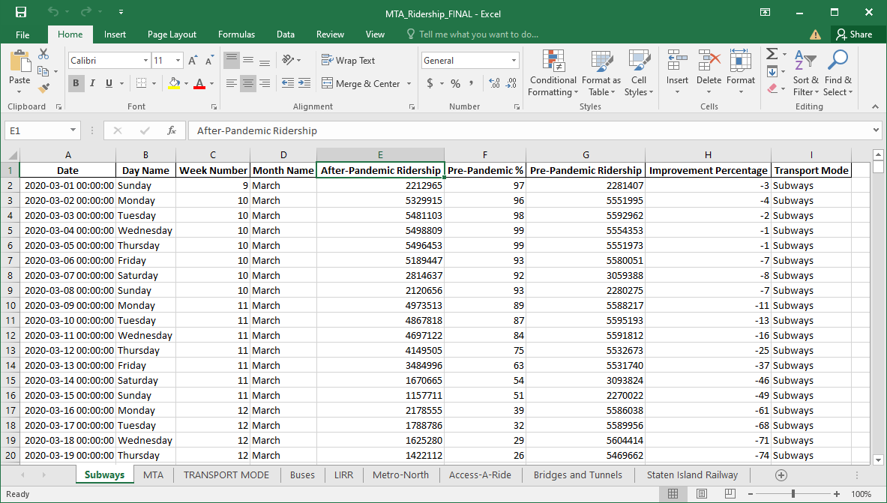
Steps in Power Query
Before and After Cleaning in Excel

Slide 10

Key DAX Calculations
Sample of Measures:
Pandemic Effect on ARR $
Lowest Trip Count Access-A-Ride
Highest Trip Count Access-A-Ride
MNR after pandemic income$
NYCT ticket average
B&T after pandemic income $
ARR-Highest Ridership %

Slide 11
Key DAX Calculations
Sample of Measures:

Slide 12

Power BI Visualization Techniques Used
Sample of Visuals used:
Line Charts – Showed ridership trends over time.
Bar Charts – Compared different MTA services.
KPI Cards – Highlighted key statistics.
Pie charts
Calender
Slicers
Multicard

Slide 13
Project Building: 1- Data Cleaning
1- Data Cleaning
2- Table Cutting
3- Create Column
4- Create Measures

Slide 14
Project Building: 1- Data Cleaning
1- Data Cleaning
2- Table Cutting
3- Create Column
4- Create Measures

Slide 15
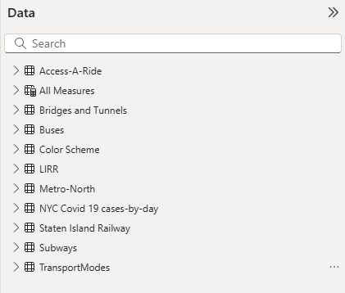
Project Building: 1- Data Cleaning
1- Data Cleaning
2- Table Cutting
3- Create Column
4- Create Measures

Slide 16
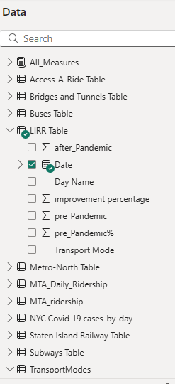
Project Building: 1- Data Cleaning
1- Data Cleaning
2- Table Cutting
3- Create Column
4- Create Measures

Slide 17
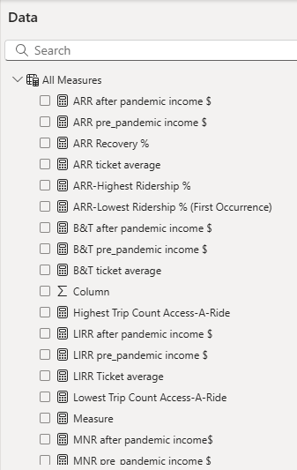
Project Building: 1- Data Cleaning
1- Data Cleaning
2- Table Cutting
3- Create Column
4- Create Measures

Slide 18


Project Building: 2- Visuals (main+7 Visuals)
B&T
NYCT
LIRR
ARR
MTABC
SIR
MNR

Slide 19
B&T
NYCT
LIRR
B&T
ARR
MTABC
SIR
MNR

Slide 20
B&T
NYCT
LIRR
B&T
ARR
MTABC
SIR
MNR

Slide 21
B&T
NYCT
LIRR
B&T
ARR
MTABC
SIR
MNR

Slide 22
B&T
NYCT
LIRR
B&T
ARR
MTABC
SIR
MNR

Slide 23
B&T
NYCT
LIRR
B&T
ARR
MTABC
SIR
MNR

Slide 24
B&T
NYCT
LIRR
ARR
MTABC
SIR
MNR

Slide 25
services
history
teams
B&T
timeline
ARR
MTABC
NYCT
MNR
SIR
LIRR

Slide 26
services
history
teams
B&T
timeline
ARR
MTABC
NYCT
MNR
SIR
LIRR

Slide 27
services
history
teams
B&T
timeline
ARR
NYCT
MNR
MTABC
SIR
LIRR

Slide 28
services
history
teams
B&T
timeline
ARR
NYCT
MNR
MTABC
SIR
LIRR

Slide 29
services
history
teams
ARR
B&T
NYCT
timeline
MTABC
MNR
SIR
LIRR

Slide 30
services
history
teams
ARR
B&T
NYCT
timeline
MTABC
MNR
SIR
LIRR

Slide 31
services
history
teams
B&T
timeline
ARR
NYCT
MNR
MTABC
SIR
LIRR

Slide 32
Key Insights from the MTA Daily Ridership Data (2020-2024)
For each transport mode, the lowest and highest ridership percentages, trip counts, and corresponding dates are listed below:
1. Subways
Lowest Ridership % (First Occurrence): April 9, 2020 → 404,635 trips (7%)
Highest Ridership %: November 10, 2023 → 3,611,367 trips (143%)
Highest Trip Count: March 4, 2020 → 5,498,809 trips (99%)
Lowest Trip Count: April 12, 2020 → 198,399 trips (8%)

Slide 33
Key Insights from the MTA Daily Ridership Data (2020-2024)
2. Buses
Lowest Ridership % (First Occurrence): March 28, 2020 → 19,745 trips (1%)
Highest Ridership %: November 10, 2023 → 1,250,528 trips (126%)
Highest Trip Count: March 5, 2020 → 2,244,515 trips (100%)
Lowest Trip Count: April 26, 2020 → 5,498 trips (1%)

Slide 34
Key Insights from the MTA Daily Ridership Data (2020-2024)
3. LIRR (Long Island Rail Road)
Lowest Ridership % (First Occurrence): April 11, 2020 → 2,749 trips (2%)
Highest Ridership %: November 10, 2023 → 224,512 trips (237%)
Highest Trip Count: March 2, 2020 → 321,569 trips (103%)
Lowest Trip Count: April 26, 2020 → 1,903 trips (2%)

Slide 35
Key Insights from the MTA Daily Ridership Data (2020-2024)
4. Metro-North
Lowest Ridership % (First Occurrence): April 1, 2020 → 9,300 trips (3%)
Highest Ridership %: November 10, 2023 → 200,669 trips (193%)
Highest Trip Count: October 29, 2024 → 249,585 trips (86%)
Lowest Trip Count: April 12, 2020 → 3,281 trips (3%)

Slide 36
Key Insights from the MTA Daily Ridership Data (2020-2024)
5. Access-A-Ride
Lowest Ridership % (First Occurrence): April 26, 2020 → 2,506 trips (13%)
Highest Ridership %: May 12, 2024 → 24,531 trips (144%)
Highest Trip Count: October 30, 2024 → 40,468 trips (136%)
Lowest Trip Count: April 26, 2020 → 2,506 trips (13%)

Slide 37
Key Insights from the MTA Daily Ridership Data (2020-2024)
6. Bridges and Tunnels
Lowest Ridership % (First Occurrence): February 1, 2021 → 156,759 trips (18%)
Highest Ridership %: January 15, 2024 → 816,628 trips (120%)
Highest Trip Count: May 12, 2023 → 1,043,802 trips (108%)
Lowest Trip Count: February 1, 2021 → 156,759 trips (18%)

Slide 38
Key Insights from the MTA Daily Ridership Data (2020-2024)
7. Staten Island Railway
Lowest Ridership % (First Occurrence): May 30, 2020 → 18 trips (0%)
Highest Ridership %: November 10, 2023 → 5,596 trips (182%)
Highest Trip Count: March 3, 2020 → 17,453 trips (109%)
Lowest Trip Count: June 21, 2020 → 0 trips (0%)

Slide 39
Observations
Observation 1: Subway ridership dropped by 60% during COVID-19 but is now recovering at 80% of pre-pandemic levels.
Observation 2: Bus ridership recovery is slower compared to subways.
Observation 3: Commuter rail services (LIRR & Metro-North) show weekday vs. weekend ridership variations.
Observation 4: Peak travel times remain consistent with pre-pandemic trends.

Slide 40

Thanks

Slide 41

Thanks

Slide 42
Thanks
We would like to express our sincere gratitude to DEPI for managing and presenting these valuable courses, providing us with an excellent learning experience.
A special thanks to CLS for their support in providing skilled instructors who have guided us throughout the training.
Most importantly, We extend our deepest appreciation to Instructor Wael Gomaa for his dedication, expertise, and insightful teaching, which have significantly enriched our knowledge. Your efforts are truly appreciated, and we are grateful for this opportunity to learn and grow. Thank you!

Slide 43
Thank You

